Slide 1

CRITICAL THINKING
How Can Critical Thinking be developed for my Study ?
STUDENT NAME : ABID ALI
STUDENT ID : 2019380141
STUDENT E-mail : abiduu354@gmail.com / 3616990795@qq.com

Slide 2

INTRODUCTION
I am Abid. My major is Computer Science. The world is now totally dependent on computer science in various aspects. I have huge expectation while taking this course. Hopefully a bright future is waiting ahead of me after completion of my study.

Slide 3
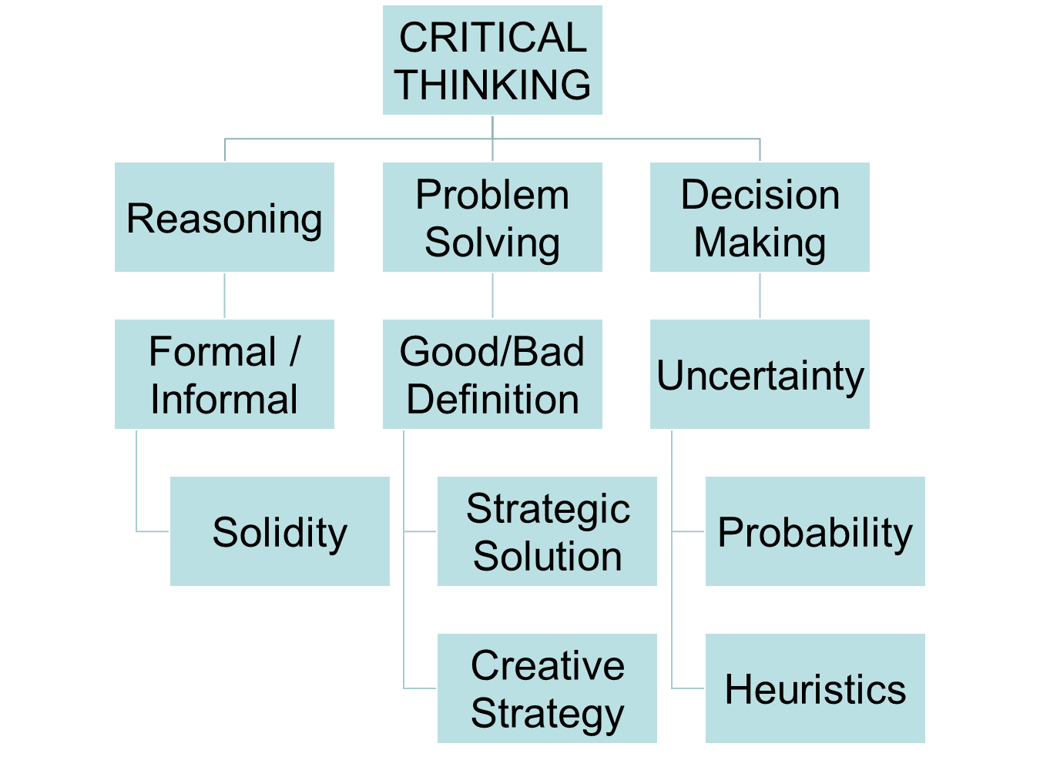

Slide 4

Critical Thinking
Critical thinking, refers to the following:
Awareness of a set of interrelated critical questions;
Ability to ask and answer critical questions at appropriate times;
Desire to actively use the critical questions.

Slide 5

Left Brain & Right Brain
FACTS
IDEAS
VERBAL
SPATIAL
STRUCTURED
OPEN-ENDED
SEQUENCE
RELATIONSHIPS
OUTLINE
INTUITIVE
LOGICAL
SUMMARY
Human Information Processing -- HIPS

Slide 6
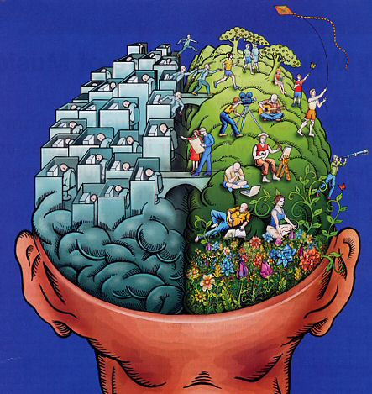

Slide 7

Examples of Critical Thinking Skills, Mindsets
And Practices are given

Slide 8
Questioning skills
How do I apply questioning skills?
I question the relevance and reliability of what I hear, read or see.
I question the authority and purpose of what I hear, read or see.
Analytical Skills
How do I apply analytical skills?
I will carefully examine ideas and information.
I systematically consider all aspects of a problem and look at each element in its wider context.
Evaluation Skills
How do I apply evaluation skills?
• I recognize flaws of reasoning.
• I consider what is implied in what I see, hear and read.

Slide 9
DEFINITION
“Creative problem solving is - looking at the same thing as everyone else and thinking something different.”
Adapted from a famous quote from a former Nobel prize winner, Albert Szent-Gyorgi.

Slide 10
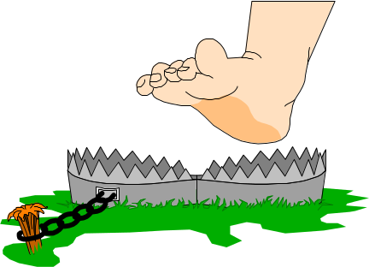
LET’S TALK ABOUT:
Like most of the student I had two questions in my mind after completing my Higher Secondary, “For higher education why China”?
Why Computer Science as major course ?

Slide 11
Why Study Higher Education in China
1. The cost of studying in China is relatively lower compared with countries such as the USA, Canada, UK, and other European countries.
2. Given the guaranteed level of quality education, international students who decide to study in China are less burdened.
3. There are also many universities and government sponsored scholarship that cover the entire cost or part of the tuition fees.
4. Cost of living in China is quiet affordable.
5. Most of the Chinese people are very warm and welcoming.

Slide 12
Why Computer Science
1. Computer is my hobby and passion from my childhood.
2. The world needs computer scientists. Computer programmers directly affect every aspect of our lives; we rely on computer scientists for this.
3. Good starting salaries.
4. Needed in almost every industry.
5. Studying computer science develops skills that are useful in any career. For example, being analytical and good at problem solving are essential skills any employer would look for.
6. Unlock my creative side

Slide 13


LINEAR THINKING | LATERAL THINKING
Move when there is a clue / direction | Move to create multiple directions
Starting from the sequence of ideas | Sequence is not followed
Every step must be correct and precise | Every step could be correct and precise
Using negation to block other paths | Don't refuse any path

Slide 14
BARRIERS THAT GET IN OUR WAY
Time
Why change?
Usually don’t need to be creative
Habit
Routine
Haven’t been taught to be creative

Slide 15
CREATIVE PROBLEM
SOLVING PROCESS
STEP 1. State what appears to be the problem.
The real problem may not surface until facts have been gathered and analyzed. Therefore, start with what you assume to be the problem, that can later be confirmed or corrected.

Slide 16
CREATIVE PROBLEM
SOLVING PROCESS
STEP 2. Gather facts, feelings and opinions.
What happened?
Where, when and how did it occur?
What is it’s size, scope, and severity?
Who and what is affected?
Likely to happen again?
Need to be corrected?
May need to assign priorities to critical elements.

Slide 17

CREATIVE PROBLEM
SOLVING PROCESS
STEP 3. Restate the problem.
The real facts help make this possible, and provide supporting data.
The actual problem may, or may not be the same as stated in Step 1.

Slide 18

CREATIVE PROBLEM SOLVING PROCESS
STEP 4. Identify alternative solutions.
Generate ideas. Do not eliminate any possible solutions until several have been discussed.

Slide 19
CREATIVE PROBLEM SOLVING PROCESS
STEP 5. Evaluate alternatives.
Which will provide the optimum solution?
What are the risks?
Are costs in keeping with the benefits?
Will the solution create new problems?

Slide 20

CREATIVE PROBLEM SOLVING PROCESS
STEP 6. Implement the decision!
Who must be involved?
To what extent?
How, when and where?
Who will the decision impact?
What might go wrong?
How will the results be reported and verified?

Slide 21
CREATIVE PROBLEM SOLVING PROCESS
STEP 7. Evaluate the results.
Test the solution against the desired results.
Make revisions if necessary.

Slide 22
Critical Thinking Skills for Continuing Study And Career Development
It will help me to make hard decisions. Equally important in the decision-making process is the ability to think critically. Critical thinking allows me to compare the pros and cons of available options, showing that I have more options than I might imagine.
Developing critical thinking abilities translates to both academic and job success. Using these skills, students tend to expand the perspectives from which they view the world and increase their ability to navigate the important decisions in learning and in life.
It will make me more employable and better paid. The best employees not only know how to solve existing problems–they also know how to come up with solutions to problems no one ever imagined.

Slide 23

THANK YOU
ANY QUESTIONS

